Slide 1

Get Your License
Keep Your License
Drive Smart!
Georgia Teen Driving Safety — Students & Parents
Presented by The Millar Law Firm – Jonesboro, GA
Notes:
Set the vibe: quick, practical, not a lecture. Goal: help you keep your freedom and stay safe.

Slide 2
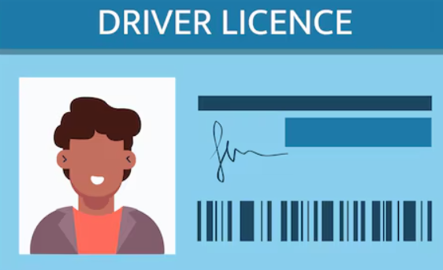

Georgia: How To Get Your License
Learner’s Permit (CP):
Apply at age 15
Proof of School Enrollment (DS-1)
Road Rules / Road Sign Test
21+ adult rides up front
Notes:
Simple ladder: CP → D → C. Remind: practice hours and night driving matter.

Slide 3

Georgia: How To Get Your License
Provisional License: “Class D”
You must be 16 (under 18)
Conditional Permit for 1 year (& a day)
ADAP Completion Certificate
40 hours supervised / 6 at night
Notes:
Simple ladder: CP → D → C. Remind: practice hours and night driving matter.

Slide 4
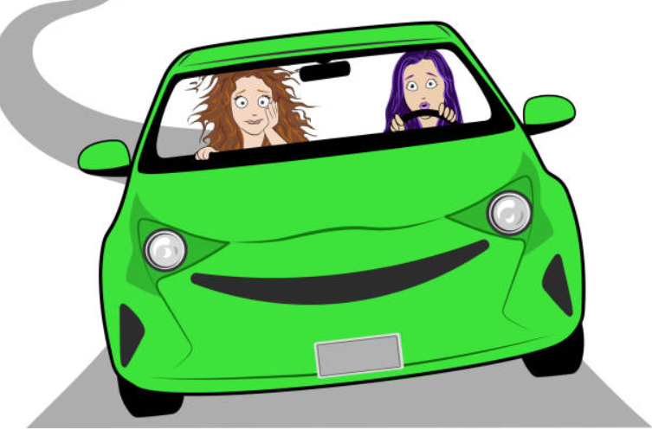
Class D Rules (Know These)
No driving 12:00–5:00 a.m.
Months 0–6: family only
Months 7–12: one friend under 21
After 12 months: up to three under 21
Notes:
Timeline on fingers helps. These are non‑family friends.

Slide 5
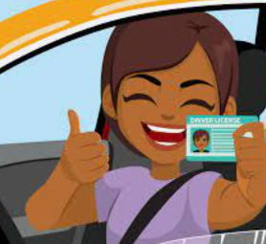
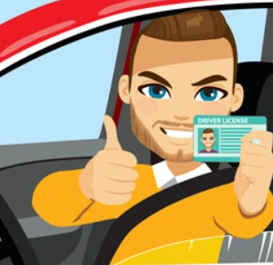
Georgia: How To Get Your License
FULL License: “Class C”
Trade in Class D → Age 18 + No violations
NO PRIOR D
Test directly (road & knowledge) and certify 40/6
or
Learners Permit + 40/6 & road test at 18
Notes:
Simple ladder: CP → D → C. Remind: practice hours and night driving matter.

Slide 6

Seat Belts & Safety Tips
Buckle every seat, every trip
Belt across chest & hips (not neck or belly)
Sit back from airbags; headrest at ear level
And yes, you can be pulled over for the belt alone.
Notes:
Quick demo with a backpack or water bottle as a ‘projectile’ example.

Slide 7
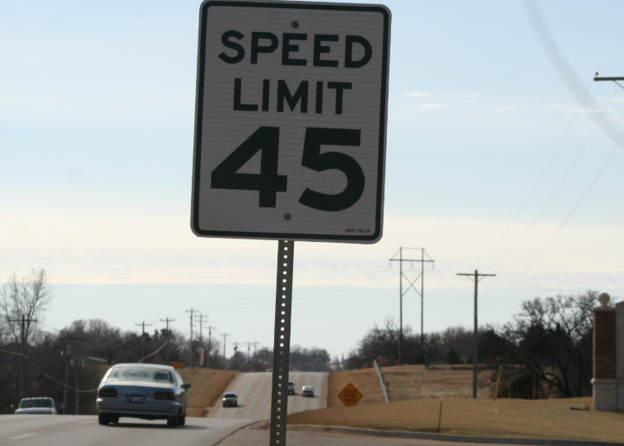
Safe Driving Habits (Easy Wins)
3–4 second following distance
Space = safety: Keep 3–4 seconds
(more in rain/night).
Count with a sign
Eyes up: scan ahead, check mirrors often
Notes:
Demonstrate a 3‑second count with a volunteer. Left‑turn rule saves crashes.

Slide 8
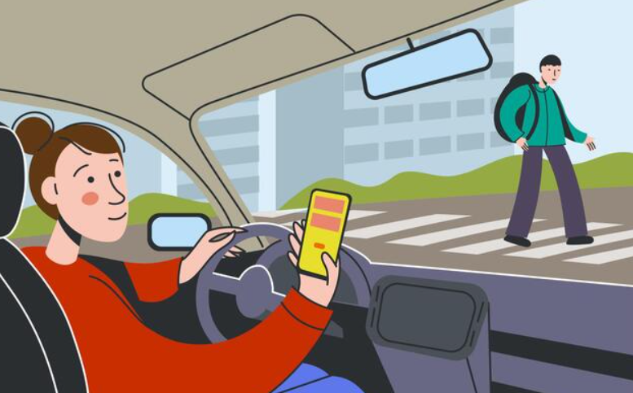
Phones: Hands‑Free or It Can Wait
Don’t hold your phone. Don’t text.
Set music & maps before you drive
If it’s urgent, pull into a safe spot
Red lights count!! just wait
There’s a reason its the law!
…and you will get a ticket!
Notes:
Hands‑Free Georgia in plain words. Glovebox trick works. Parents too.

Slide 9
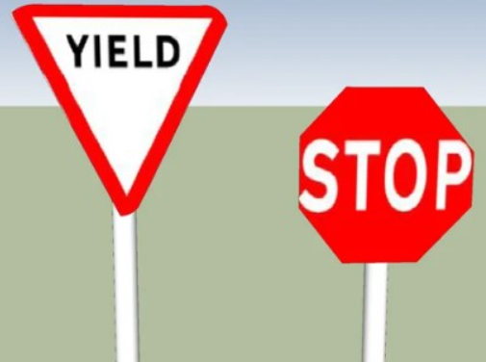
Road Signs You’ll See Everywhere
STOP vs. YIELD
(full stop vs. slow and yield the right of way)
Slow and be Ready to Stop
Must make a FULL STOP
Notes:
Keep this fast—ask the room quick: which one surprises people most? Mention school zone times posted.

Slide 10
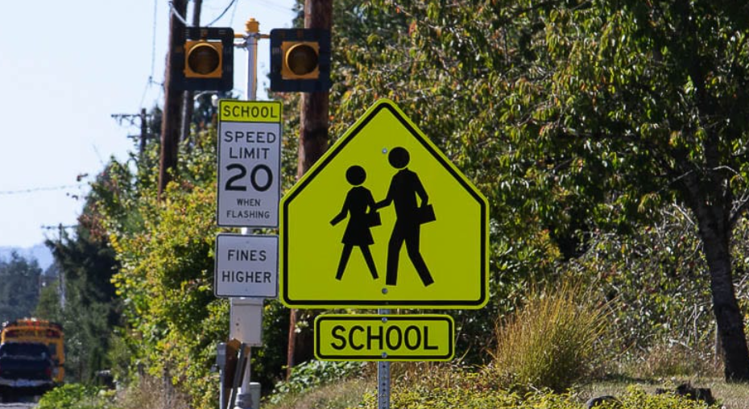
Road Signs You’ll See Everywhere
Speed Limit & School Zone
(watch the flashing times)
Notes:
Keep this fast—ask the room quick: which one surprises people most? Mention school zone times posted.

Slide 11
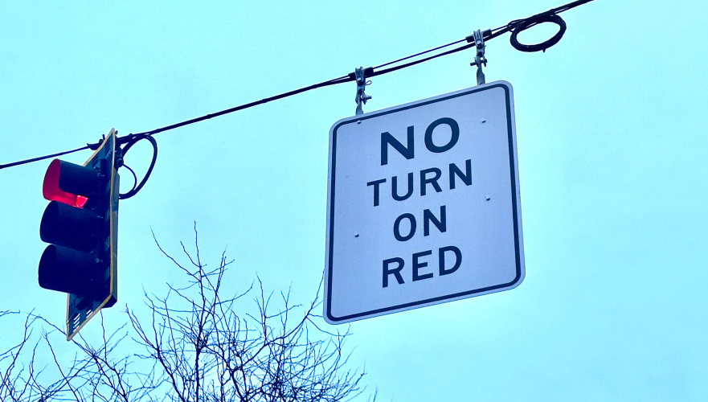
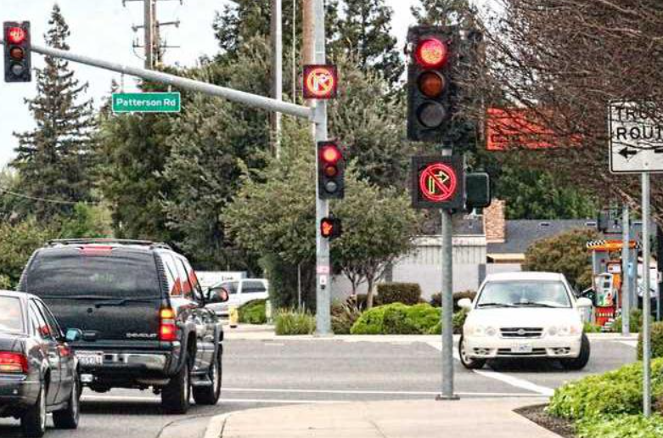
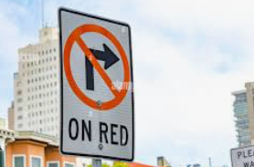
Road Signs You’ll See Everywhere
No Turn on Red (look for the sign)
Notes:
Keep this fast—ask the room quick: which one surprises people most? Mention school zone times posted.

Slide 12
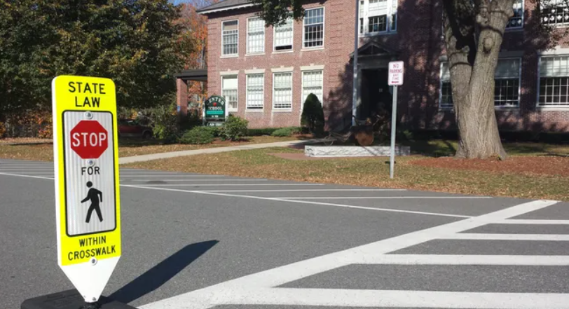
Road Signs You’ll See Everywhere
STOP for Pedestrian in Crosswalk
Notes:
Keep this fast—ask the room quick: which one surprises people most? Mention school zone times posted.

Slide 13


Fender‑Bender? Do This
Check for injuries & call 911
Move to a safe spot
Swap info & take pics
Call a parent/guardian
DON’T LEAVE THE SCENE
Under 21: 6 month or 12 month suspension
All Drivers:
Charges range from misdemeanor to felony.
Notes:
Short, clear checklist. Mention insurance questions go to parents after.

Slide 14



Traffic Rules That Trip People Up
4‑Way Stop
tie →
driver on the right goes
Notes:
Use hand signals for who goes first at a 4‑way. Stress the median exception for buses.

Slide 15
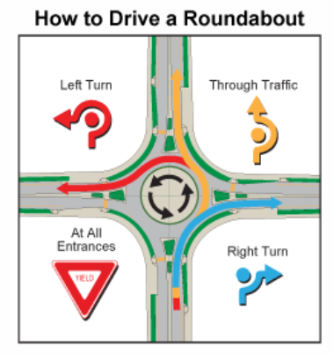
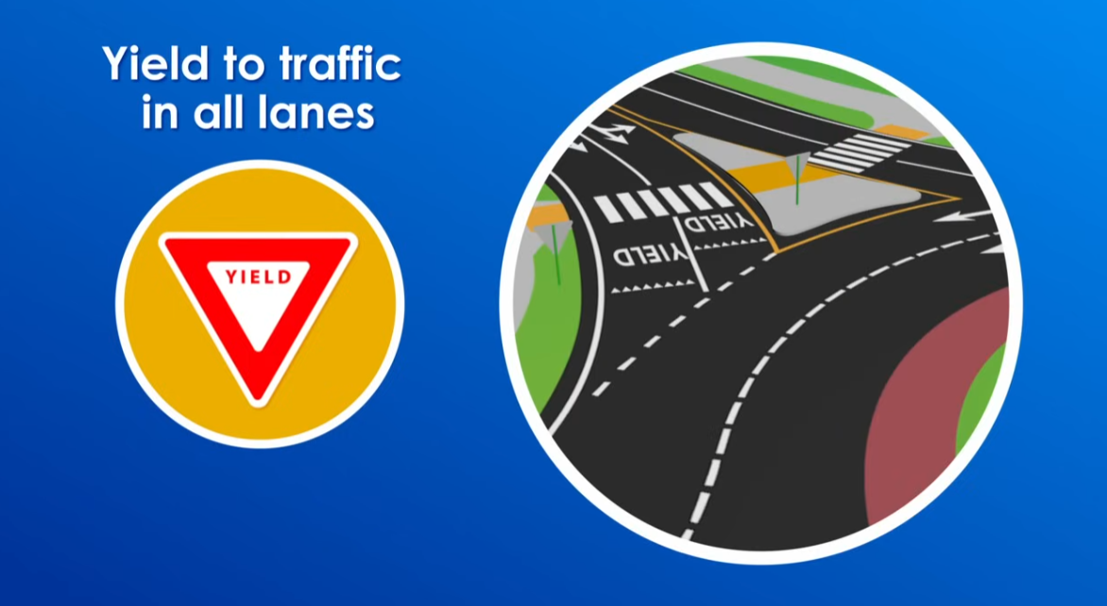
Traffic Rules That Trip People Up
Roundabouts: yield to cars already in the circle
Notes:
Use hand signals for who goes first at a 4‑way. Stress the median exception for buses.

Slide 16
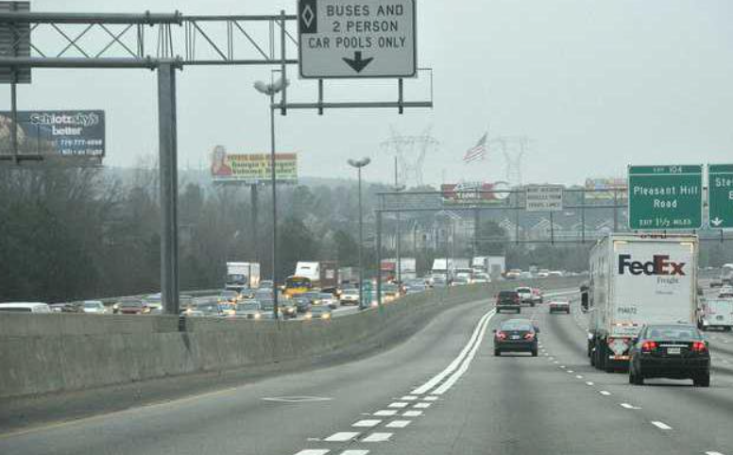
Traffic Rules That Trip People Up
Lane Lines
dashed = pass when clear solid = don’t pass
Notes:
Use hand signals for who goes first at a 4‑way. Stress the median exception for buses.

Slide 17
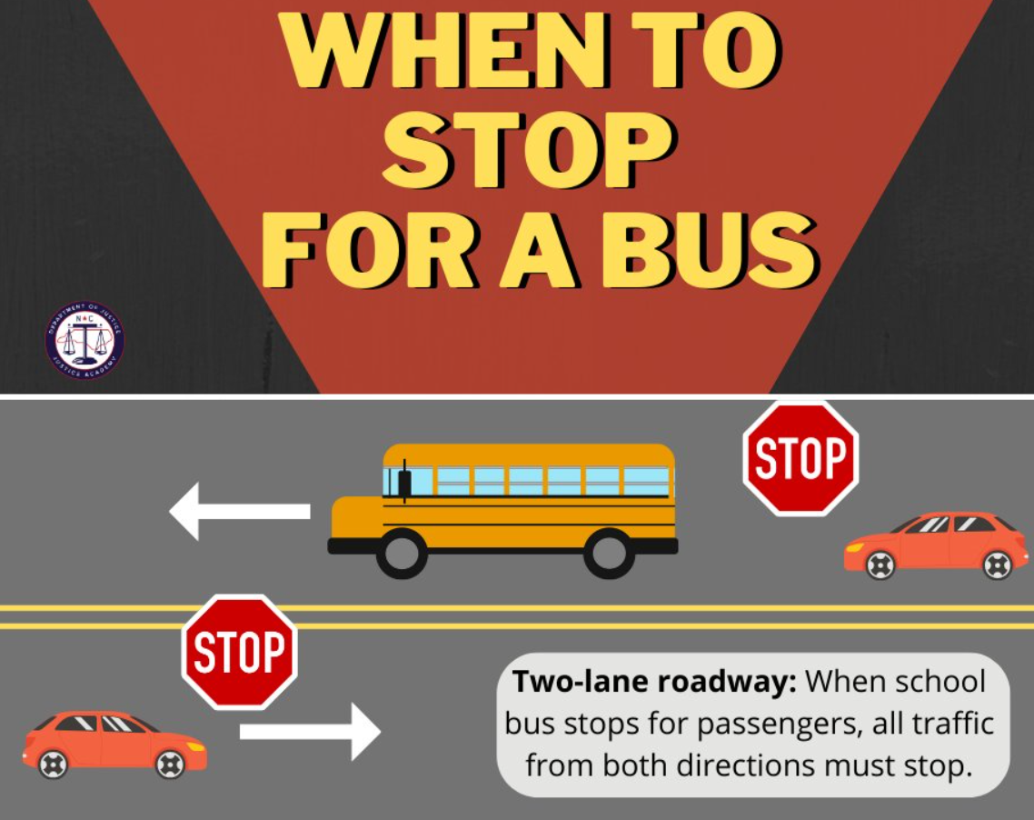

Traffic Rules That Trip People Up
School Bus: red flashers = stop
Notes:
Use hand signals for who goes first at a 4‑way. Stress the median exception for buses.

Slide 18
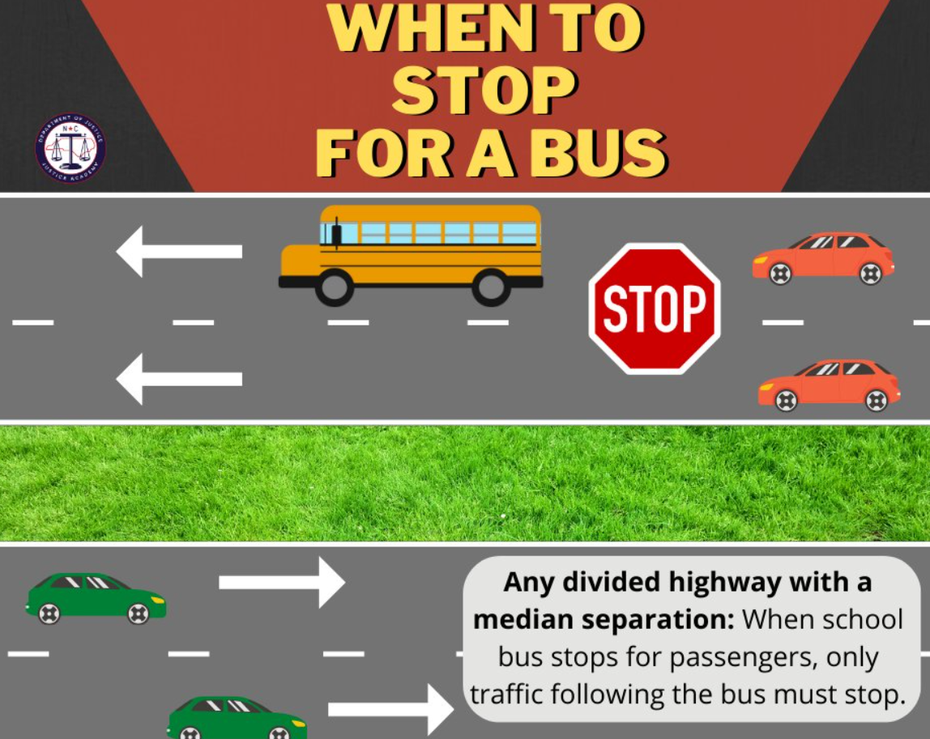
Traffic Rules That Trip People Up
School Bus: red flashers = stop
Unless there is a divided highway
AND
a median
Notes:
Use hand signals for who goes first at a 4‑way. Stress the median exception for buses.

Slide 19

Impaired Driving: Zero Is the Plan
Under 21
.02 is basically zero
.02 = LESS than one drink
Alcohol, weed, meds = Don't Drive !
Have a ride plan—no questions asked
Notes:
Offer two promises: don’t ride with an impaired driver; call for help anytime.

Slide 20

THANK YOU
Scan the QR code to
download this presentation
770-400-0000
AtlantaAdvocate.com
Notes:
Set the vibe: quick, practical, not a lecture. Goal: help you keep your freedom and stay safe.

